Slide 1
RCS Technical Architecture Overview

Slide 2
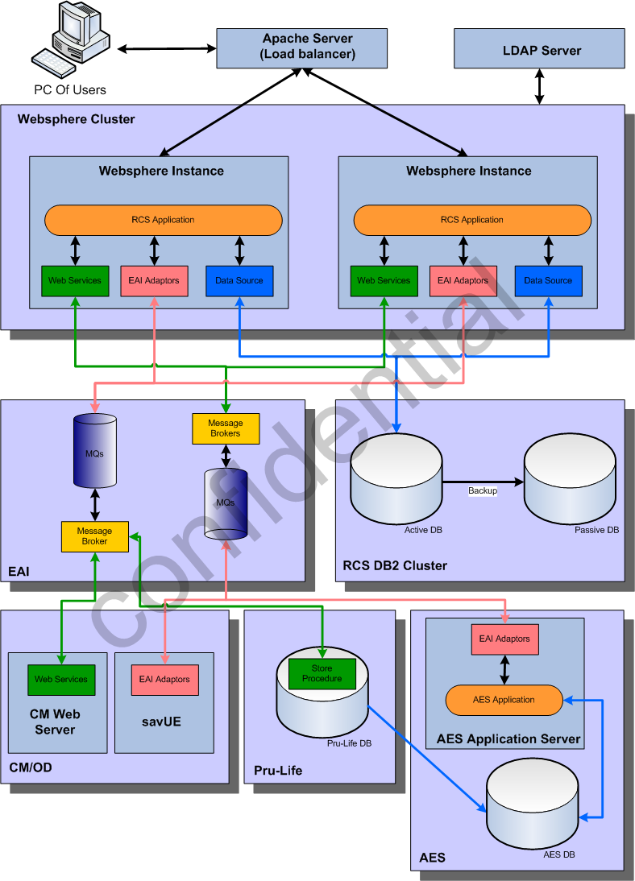
PACHK Impl Archetecture

Slide 3
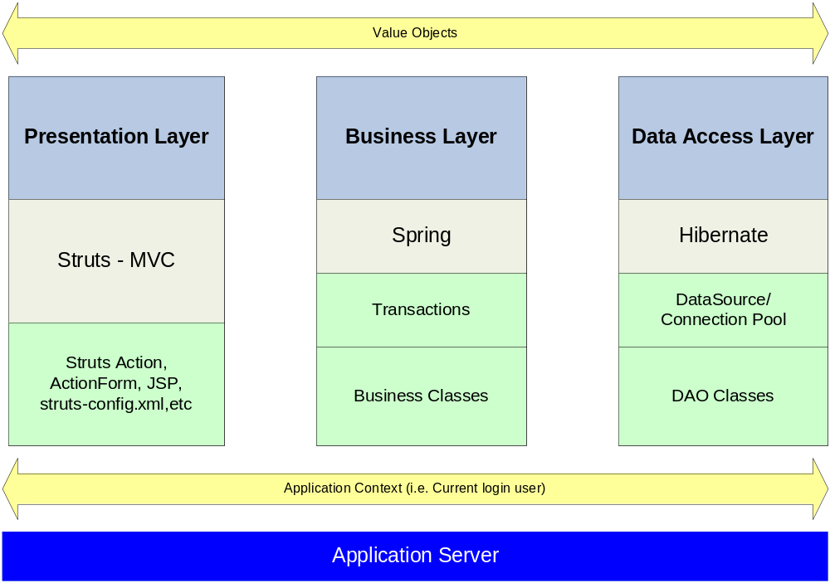
Architecture Overview

Slide 4
Technologies
  Struts 1.2.9
  Spring 2.5
  - IOC
  - Transaction Management
  - Spring Security
  Hibernate 3.0
  jBPMs – Workflow Engine
  Drools – Rule Engine
  ValueList – DataGrid (http://valuelist.sourceforge.net/)
  - Pagination
  - Sorting
  - Data Export

Slide 5
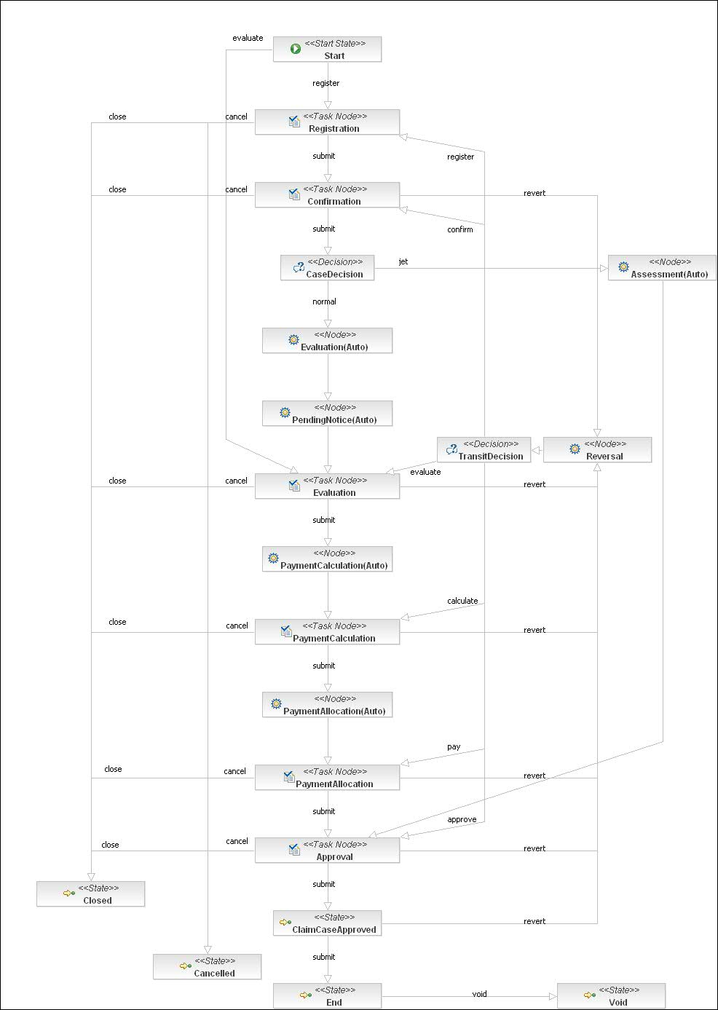

WorkFlow Engine: JBPM
Click to see the original picture

Slide 6
JBPM – Key Concepts
Process instance: A process instance is one execution of a process definition.
Token: A token is one path of execution. A token is the runtime concept that maintains a pointer to a node in the graph. When a process instance is created, a token is created for the main path of execution. This token is called the process instance's root token and is positioned in the process definition's start state.
Signal: A signal instructs a token to continue graph execution by transition out of a node.
Node: Nodes are responsible for the continuation of a graph execution. When a token enters a node, the node executes. A node that does not propagate execution is regarded as a state.
Action: Actions are instances of Java code executed when events occur in a process execution. The primary event types are "entering a node," "leaving a node," and "taking a transition."

Slide 7
JBPM – Process Instance
- One process instance per claim case
- Process instance created after registration

Slide 8
JBPM – TaskNode
TaskNode
<task-node name="Confirmation" end-tasks="true">
<event type="task-create">
<action class="org.springmodules.workflow.jbpm31.JbpmHandlerProxy" config-type="bean">
<factoryKey>jbpmConfiguration</factoryKey>
<targetBean>stagePretreatmentAction</targetBean>
</action>
</event>
<task>
<assignment class="org.springmodules.workflow.jbpm31.JbpmHandlerProxy" config-type="bean">
<factoryKey>jbpmConfiguration</factoryKey>
<targetBean>assignmentHandler</targetBean>
</assignment>
</task>
<transition to="CaseDecision" name="submit"></transition>
<transition to="Reversal" name="revert"></transition>
<transition to="Closed" name="close"></transition>
<transition to="Cancelled" name="cancel"></transition>
</task-node>

Slide 9
JBPM – AutoNode
AutoNode
<node name="Evaluation(Auto)">
<event type="node-enter">
<action class="org.springmodules.workflow.jbpm31.JbpmHandlerProxy" config-type="bean">
<factoryKey>jbpmConfiguration</factoryKey>
<targetBean>evaluationAutoAction</targetBean>
</action>
</event>
<transition to="PendingNotice(Auto)"></transition>
</node>

Slide 10
User Authority Management
Group Based User Management
Role Based Function Access Control
Configurable Matrix Based Authority Control

Slide 11
User Authority Management
Role
Group
User
Function point: a token to control if user can access a function
Role: a set of function points
Group: present the team structure/org-chart

Slide 12
User Authentication
Can be configured to one of these:
RCS built-in authentication
user accounts stored in RCS tables
LDAP authentication
user accounts stored outside RCS

Slide 13
Business Date
Rather than system date relying on Operating System, RCS exploits OS-independent “business date”, which is configurable within RCS application.
Business date can be configured as:
Centralized biz date stored in table SYSINFO
User level specific biz date stored in user table
There are different modes of retrieving business date, which is controlled
by parameter bizDateRetrievingMode in claims.properties:
0 - always load the biz date from table SYSINFO
1 - load user-level biz date at first. If not specified, load from table SYSINFO
2 - load user-level biz date at first. If not specified, load machine system date.
3 - always load machine system date

Slide 14
Business Date
Biz date can be retrieved via BizDateUtil.getBusinessDate().
Example fields which should be set with biz date:
Registered Date
Approved Date
Rejected Date
Example fields which should be set with OS system date:
Last Modified Date
Created Date

Slide 15
Report/Letter
Refer to “RCS Solution for Report & Letter v0.2.ppt”

Slide 16
Regional/Country Layer Segregation
Refer to “RCS_ArchImprovement_1a Regional Core Design and Dev Guidelines_v1.2”

